Slide 1
Displaying Data from multiple tables
using joins
1

Slide 2
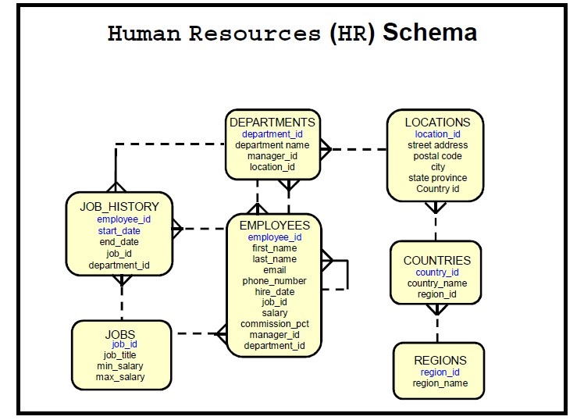
2

Slide 3
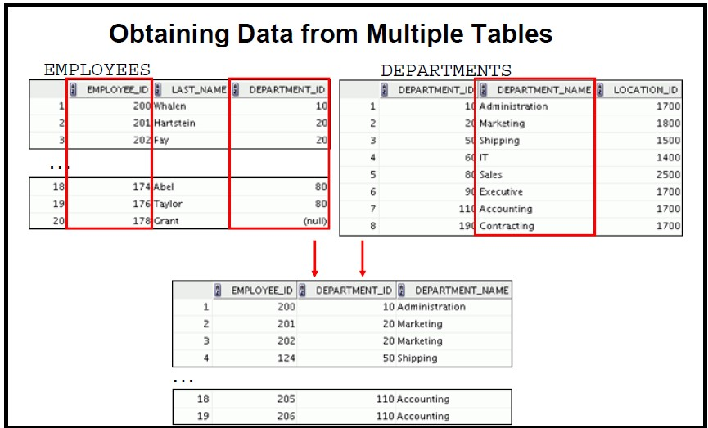
3

Slide 4
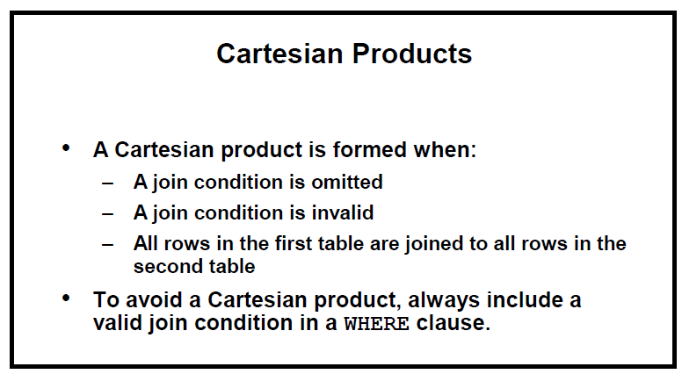
4

Slide 5
SELECT EMPLOYEES.EMPLOYEE_ID , EMPLOYEES.FIRST_NAME, EMPLOYEES.DEPARTMENT_ID, DEPARTMENTS.DEPARTMENT_NAME
FROM EMPLOYEES,
DEPARTMENTS
ORDER BY EMPLOYEE_ID;
5

Slide 6
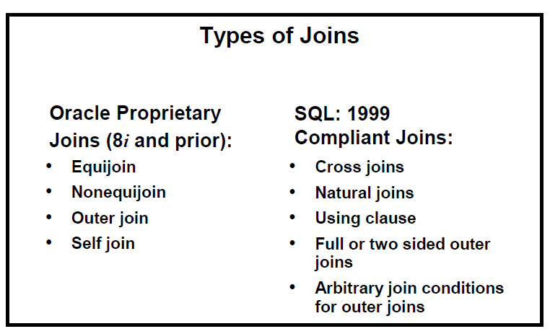
6

Slide 7
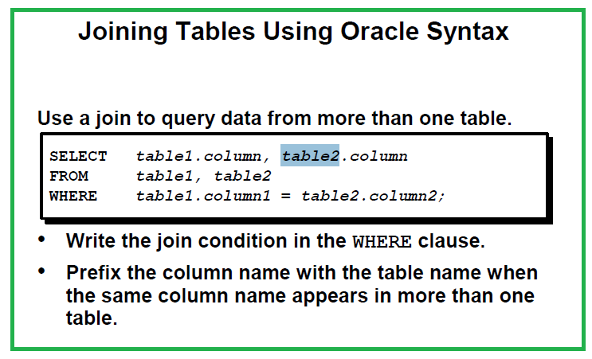
7

Slide 8
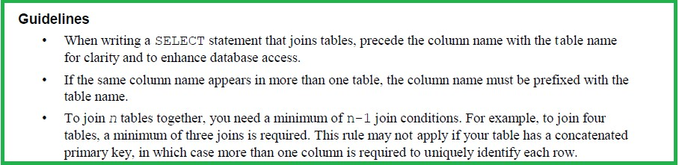
8

Slide 9
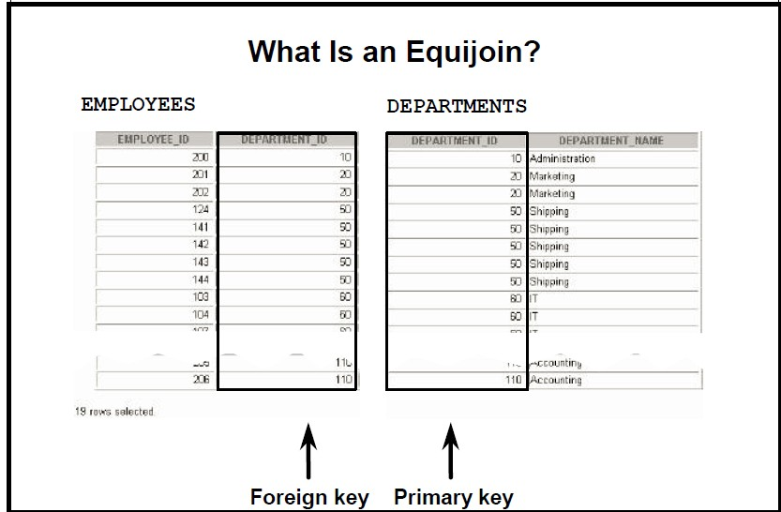
9

Slide 10
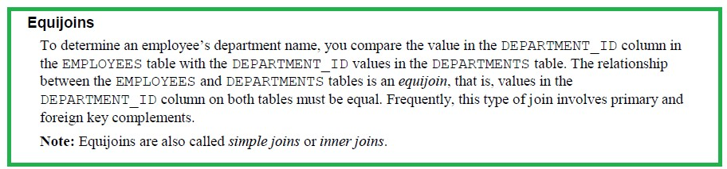
10

Slide 11
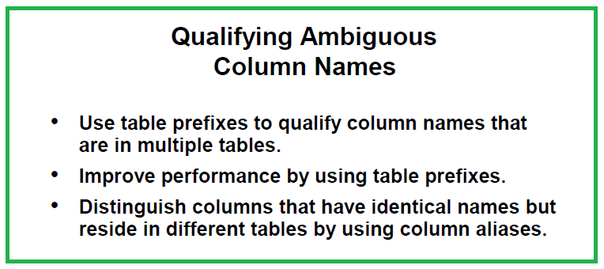
11

Slide 12
SELECT
EMPLOYEES.EMPLOYEE_ID , EMPLOYEES.FIRST_NAME, EMPLOYEES.DEPARTMENT_ID, DEPARTMENTS.DEPARTMENT_NAME FROM
EMPLOYEES, DEPARTMENTS
WHERE EMPLOYEES.DEPARTMENT_ID=DEPARTMENTS.DEPARTMENT_ID
ORDER BY EMPLOYEE_ID;
12

Slide 13
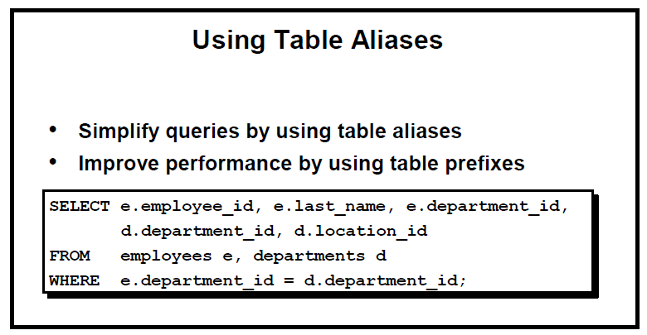
13

Slide 14
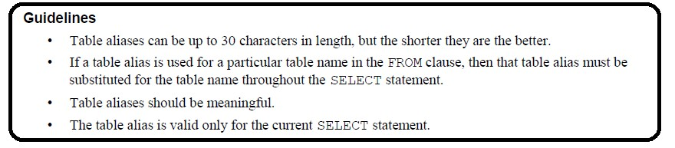
14

Slide 15
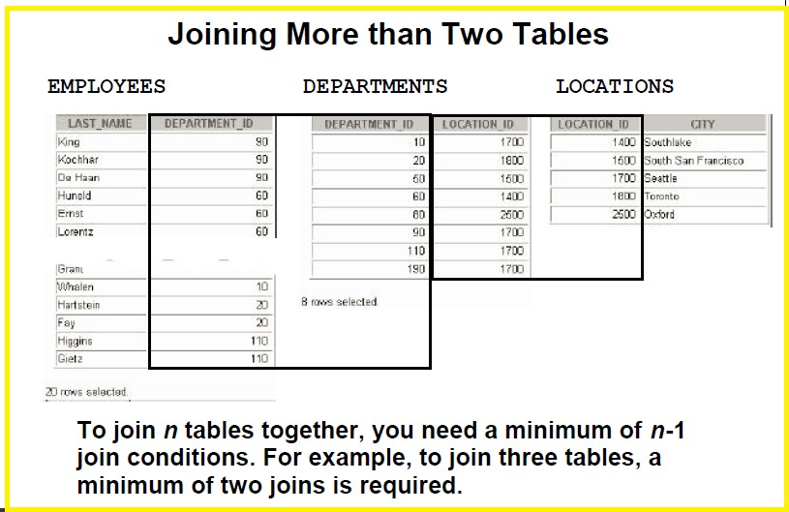
15

Slide 16
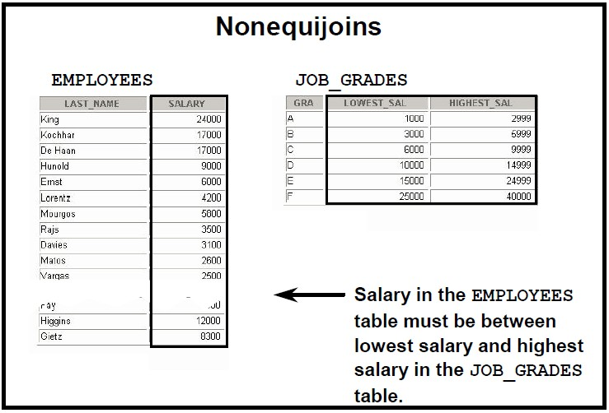
16

Slide 17
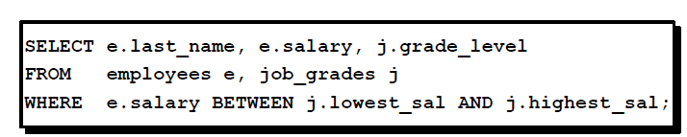
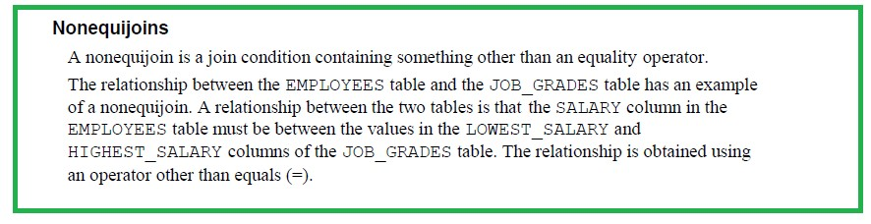
17

Slide 18
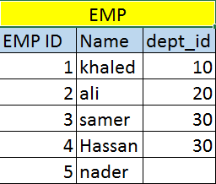
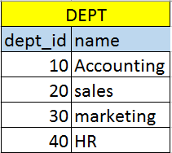
Outer Join
Main table
Emp ID 5 has no department
So if you used natural join emp.dept_id=dept.dept_id, then he will not appear
So we have to use outer join (+), always place it on the side that have the missing data where emp.dept_id=dept.dept_id(+)
18
12

Slide 19
If a FK in table1 has null values and it is the main table that you want to display the data from, then the outer join should be table2 side which has the reference from table1
19

Slide 20
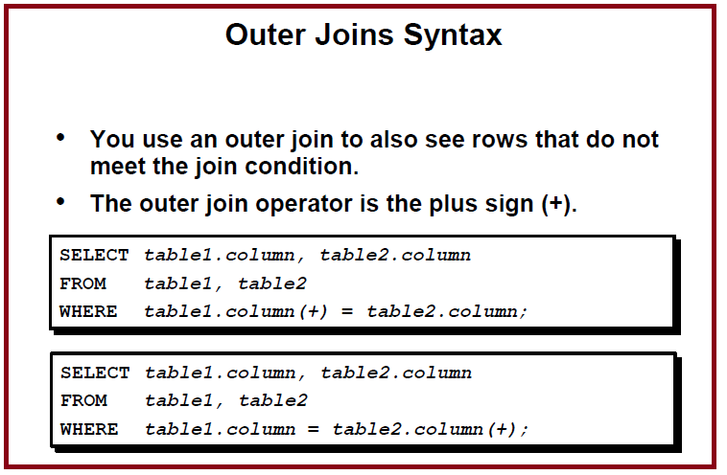
20

Slide 21
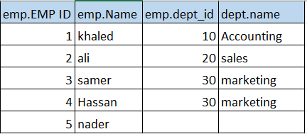
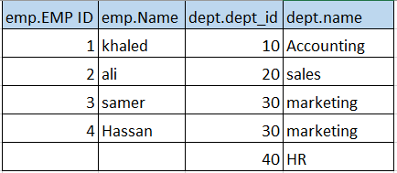
Outer Join
Where emp.dept_id=dept.dept_id(+)
Where emp.dept_id(+)=dept.dept_id
21

Slide 22
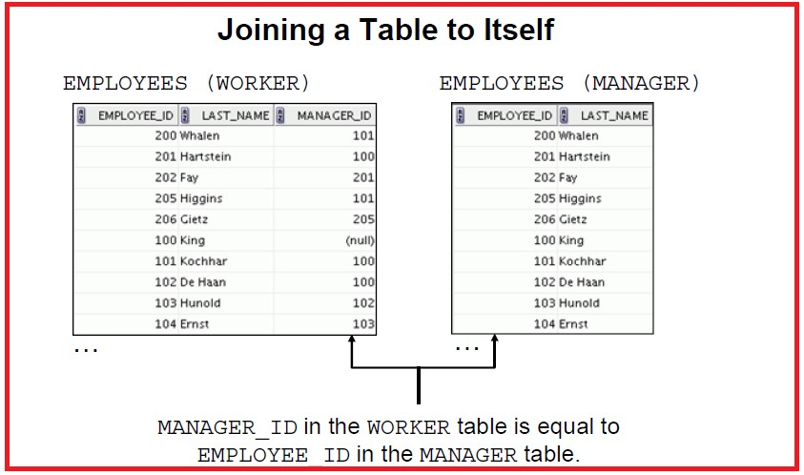
22

Slide 23
SELECT
WORKER.EMPLOYEE_ID,
WORKER.FIRST_NAME, WORKER.MANAGER_ID,
manager.first_name
FROM
EMPLOYEES WORKER,
EMPLOYEES MANAGER
WHERE WORKER.MANAGER_ID=MANAGER.EMPLOYEE_ID;
23

Slide 24
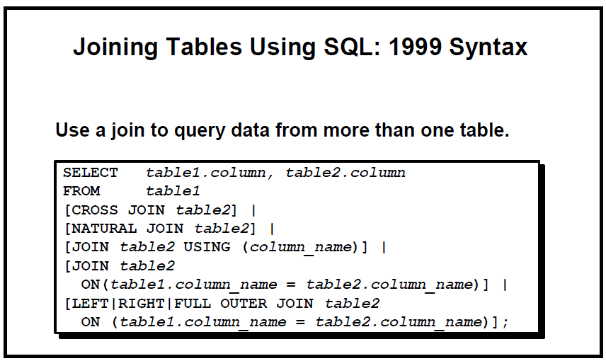
24

Slide 25
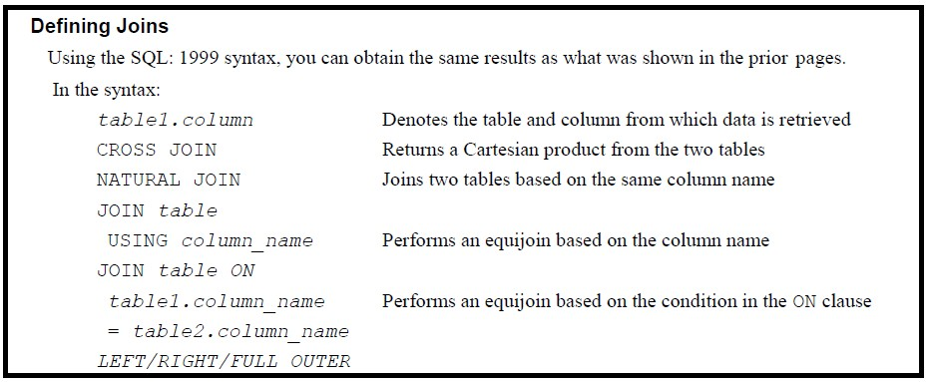
25

Slide 26
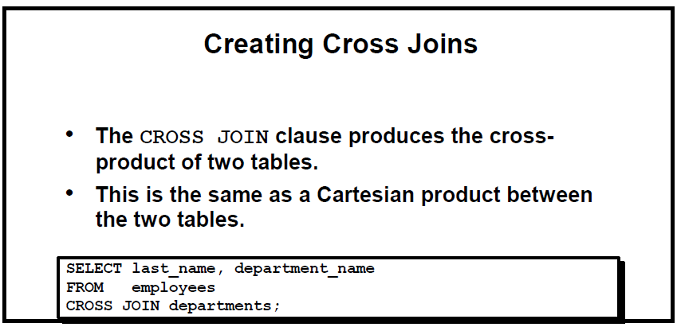
26

Slide 27
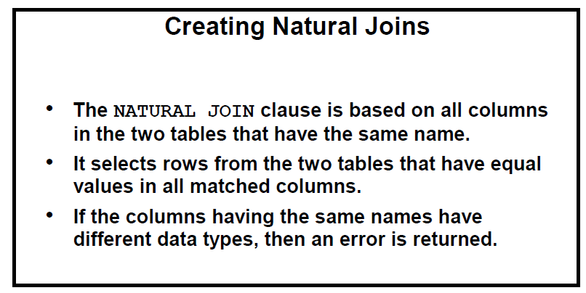
27

Slide 28
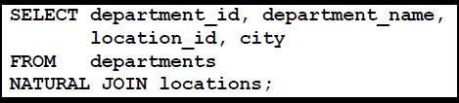
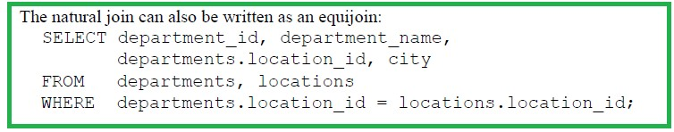
1999 Format
Old Format as Equijoin
28

Slide 29
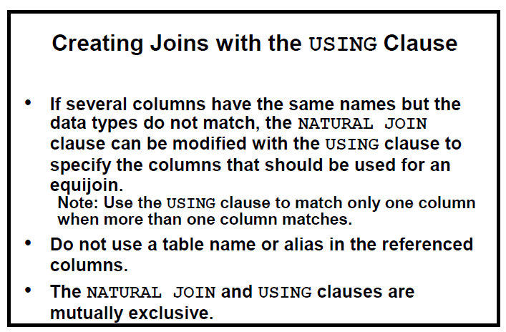
29

Slide 30

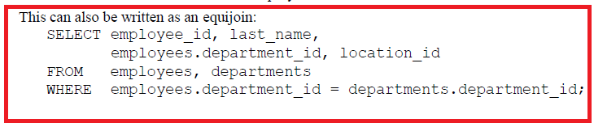
30

Slide 31
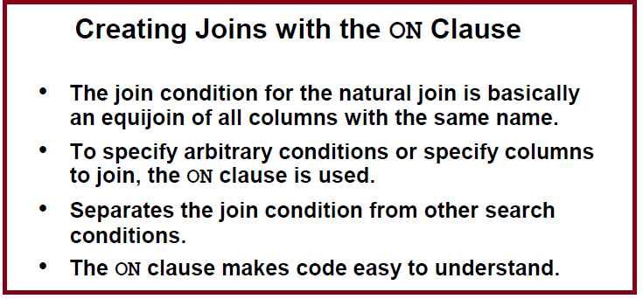
31

Slide 32
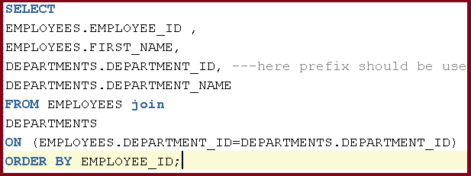
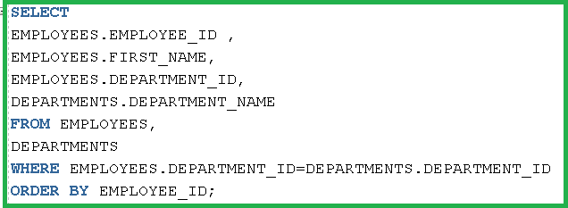
1999 format
Old Format
32

Slide 33
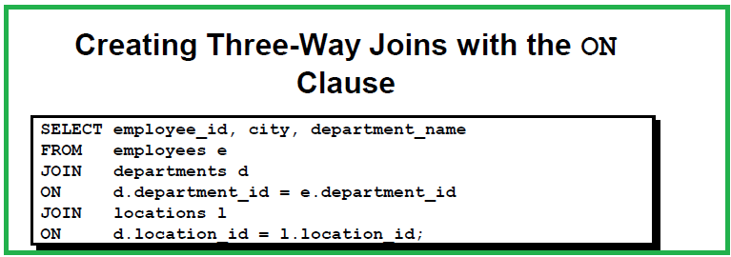
33

Slide 34
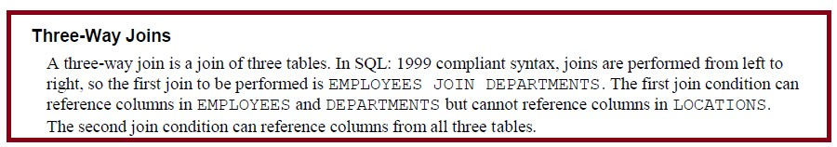
34

Slide 35
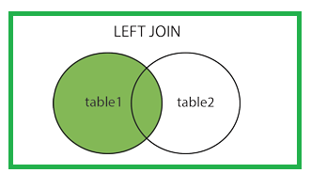
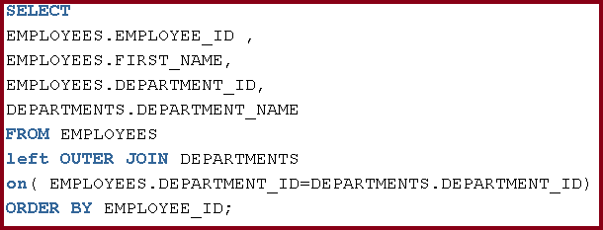
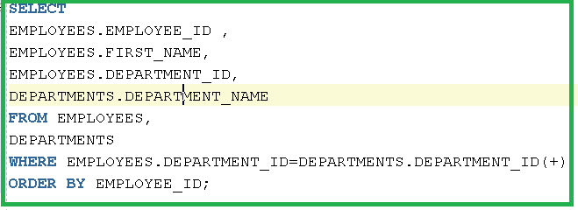
Left Outer Join
35

Slide 36
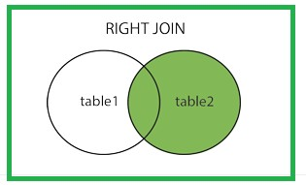
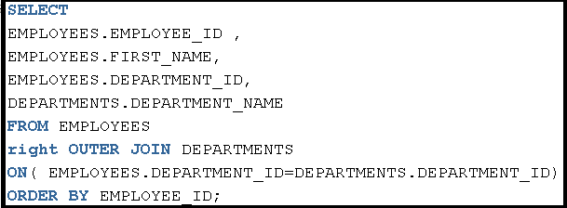
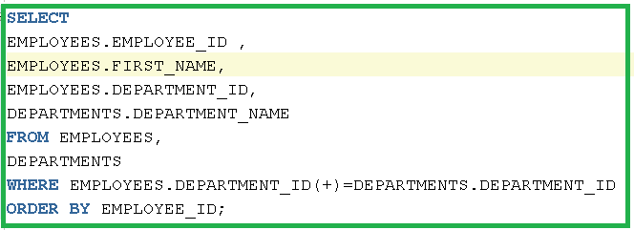
Right Outer Join
36

Slide 37
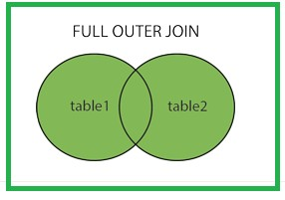
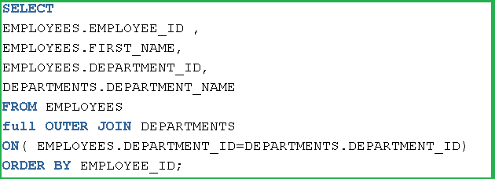
full Outer Join
37

Slide 38
Thank You
25

